Slide 1
ACUTE RHINOSINUSITIS
Dr.Haval Ahmed Hama
MBChB, F.K.B.M.S
(Otolaryngology, Head and Neck Surgeon)
University of Sulaymaniyah, College of Medicine.
Branch Of Clinical Science.

Slide 2
DEFINITION
Rhinosinusitis (RS):-
is an inflammation of the nose and paranasal sinuses.
It accounts for about 6%-15% of visits to primary care physicians.

Slide 3
TYPES OF RHINOSINUSITIS
Acute Rhinosinusitis (< 4 weeks duration)
Viral Rhinosinusitis (VRS)
Acute Bacterial Rhinosinusitis (ABRS)
Subacute Rhinosinusitis (4–12 weeks duration)
Chronic Rhinosinusitis (> 12 weeks duration)
With Polyps
Without Polyps
Recurrent Acute Rhinosinusitis (3 episodes in 6 months or 4 or > 4 episodes of acute RS in 1 year)

Slide 4
Pansinusitis is the term applied to inflammation of all the paranasal sinuses, whereas individual sinus involvement is named accordingly such as acute maxillary sinusitis, acute ethmoiditis, acute frontal sinusitis, or acute sphenoiditis.
The commonly involved sinuses are maxillary and ethmoid.

Slide 5
Acute Rhinosinusitis(ARS)
ARS is a very common condition that is predominantly managed in primary care and hence rarely seen by hospital specialists unless complications occur.
The primary cause of ARS is viruses and only 0.5–2.0% of patients are believed to develop ABRS.

Slide 6
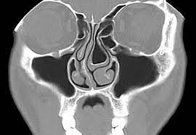
Predisposing factors to ARS
Anatomical factors (e.g. Haller/infra-orbital ethmoid cells, conchae bullosa), DNS
Allergy
Smoking
Poor mental health.

Slide 7
ACUT VIRAL RHINOSINUSITIS (COMMON COLD)
The common viruses are include rhinoviruses (50%), influenza and parainfluenza viruses, adenovirus, respiratory syncytial virus, and enterovirus.
They are spread by aerosolized droplets through coughing and sneezing.
The incubation period is 1-4 days.
Complications are uncommon, as the disease is self-limiting.
Less than 2% progress to ABRS, & cause pharyngitis/bronchitis/pneumonia/OM
Unless complicated by bacterial infection, the patient improves within a week to 10 days.

Slide 8
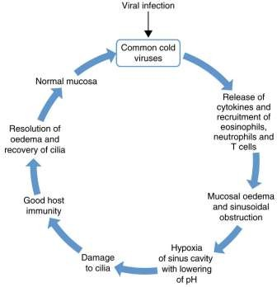
Pathophysiology

Slide 9
ACUTE VIRAL RHINOSINUSITIS
CLINICAL FEATURES
Usually AVRS begins with sore throat, which lasts for 1 or 2 days
followed by cough and nasal discharge.
In beginning there may be burning sensation at the back of nose, nasal stuffiness, rhinorrhea and sneezing.
Patient has chill and low-grade fever.
Nasal watery discharge is profuse and may become mucopurulent due to secondary bacterial invasion

Slide 10
ACUTE VIRAL RHINOSINUSITIS
TREATMENT:
There is no approved treatment, mainly symptomatic.
Symptoms can be easily controlled with antihistaminics.
Oral decongestants may cause insomnia and agitation.
Analgesics are useful to relieve headache, fever & myalgia.
Antibiotics have no role in AVRS.
Nasal saline sprays/ nasal decongestants are useful.
General: Bed rest and plenty of fluids are encouraged.

Slide 11
ACUTE BACTERIAL RHINOSINUSITIS
This usually follows viral upper respiratory infection.
The most common bacteria responsible for ABRS are Streptococcus pneumoniae, Haemophilus influenzae, Moraxella catarrhalis and Staphylococcus aureus

Slide 12
ACUTE BACTERIAL RHINOSINUSITIS
Predisposing Factors are following:
Viral rhinosinusitis
Allergic rhinosinusitis
Trauma
Physical stigmata such as DNS
Swimming and diving
Barotraumas.
Dental infections and extraction of upper molars and premolars.

Slide 13
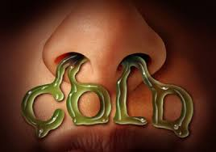
Symptoms Or Signs for Acute Bacterial Rhinosinusitis
At least three of the following should be present:
• Discolored discharge (unilateral predominance)
• Severe local pain (unilateral predominance)
• Fever (>38°C)
• Elevated ESR/CRP
• ‘Double-sickening’ – deterioration after initial milder phase of illness

Slide 14
ACUTE BACTERIAL RHINOSINUSITIS
EXTERNAL SIGNS
Flushing of cheek with swelling of cheek, which may spread to lower lid in maxillary sinusitis.
Upper lid may be swollen in frontal sinusitis.
Ethmoiditis may give rise to swelling at the inner canthus of same eye.
Tenderness over the affected sinus.
Cheek: Maxillary sinusitis.
Floor of sinus: Frontal sinusitis.
Inner canthus: Ethmoids.

Slide 15
Complication of sinusitis
Orbital | Intracranial | Bony | Chronic
Preseptal cellulitis (50%) | Sub dural empyema (38%) | Osteomyelitis & Pott’s puffy tumour | Mucocele & pyocele
Postseptal cellulitis or orbital cellulitis without abscess (35%) | Intracranial abscess (30%)
Subperiosteal abscess (15%) | Extradural abscess (23%)
Orbital abscess (<1%) | Meningitis (2%)
Cavernous sinus thrombosis | Cavernous or sagittal sinus thrombosis

Slide 16
INVESTIGATIONS
Hematology: leukocytosis, elevated CRP, elevated ESR.
Culture sensitivity test.

Slide 17
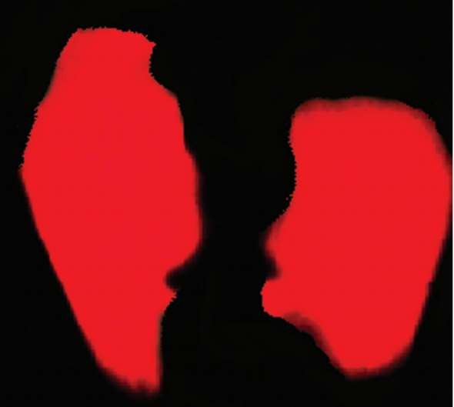
3-Transillumination test.
Maxillary sinus—absence of infraorbital crescent of light and pupillary glow indicates sinusitis.
Frontal sinus transillumination: not very informative.
-Interpretations:
Normal: Typical light transmission
Dull: Reduced light transmission
Opaque: No light transmission

Slide 18
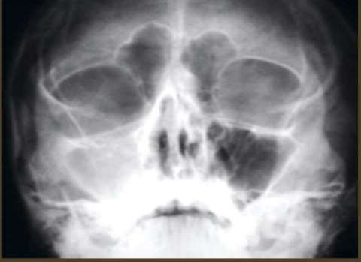
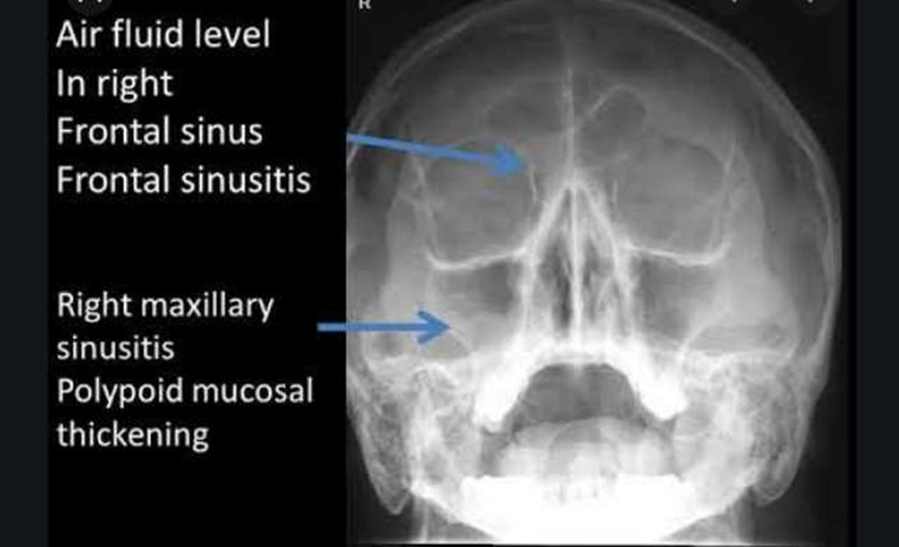
4-X-ray paranasal sinuses (PNS) to demonstrate fluid level, or opacity.

Slide 19
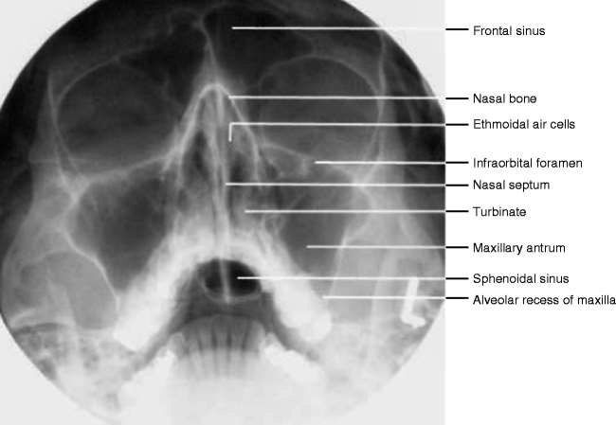
XRAY PARANASAL SINUSES

Slide 20
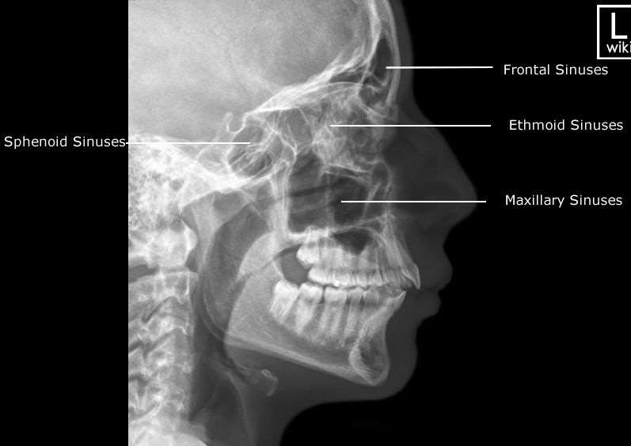
XRAY PARANASAL SINUSES

Slide 21
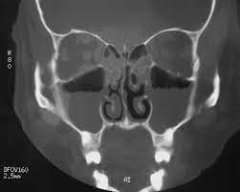
4-Computed tomography (CT) scan—coronal CT may show thickening of mucosa or opacification with occlusion of the maxillary sinus.

Slide 22
ACUTE BACTERIAL RHINOSINUSITIS
Medical Treatment:
Antibiotics Amoxicillin-Clavulanic acid 1gm two times daily or any other broad-spectrum antibiotic (BSA) for 10 to 14 days and not one week to avoid recurrence. If there is no response in 3 to 5 days, change over to clarithromycin/azithromycin/ cefixime.
Local decongestants: oxymetazoline/xylometazoline nasal drops followed by steam inhalation (which liquefies the thick viscid secretions).
Analgesics: paracetamol and codeine preparation.
Local application of heat by hot water bottle for about 10 minutes, three times a day is comforting, relieves pain, and promotes drainage.

Slide 23
ACUTE BACTERIAL RHINOSINUSITIS
Surgery:
The surgery is reserved for patients with threatened intraorbital or intracranial complications.
The reported success of endoscopic sinus surgery is about 80–90%.
It is indicated in the following conditions:
-Persistent disease despite medical therapy.
-Recurrent RS with identifiable and related anatomical or acute pathological abnormalities in the osteomeatal complex.

